Slide 1
SATHYABAMA UNIVERSITY
UNIT-V
English for Science and Technology –SHS1101
UNIT V
The Less Travelled Road
Listening and summarizing, Making presentations on given topics – Giving impromptu talks, Reading and Summarizing, E-mail writing, Rearranging the Jumbled sentences, Reported Speech, Homophones/Homonyms, Creative Writing & Poster making using similes/metaphors.
Listening and summarizing:
The most challenging part is to comprehend the speaker and to summarize it in an effective manner in the words of your own.
Even before involving in listening activity a little practice on summarizing will be more effective.
A summary is a shortened version of a text. It contains the main points in the text and is written in your own words. It is a mixture of reducing a long text to a short text, selecting relevant information and ignoring irrelevant information. A good summary shows that you have understood the text.
Look at this example:
The amphibia, which is the animal class to which our frogs and toads belong, were the first animals to crawl from the sea and inhabit the earth.
Summary
The first animals to leave the sea and live on dry land were the amphibia.
(The phrase "which is the animal class to which our frogs and toads belong" is an example, not a main point, and can be deleted. The rest of the text is rewritten in your own words.)
TRY THIS!!
People whose professional activity lies in the field of politics are not, on the whole, conspicuous for their respect for factual accuracy.
Failure to assimilate an adequate quantity of solid food over an extended period of time is absolutely certain to lead, in due course, to a fatal conclusion.
Page 1 of 27

Slide 2
SATHYABAMA UNIVERSITY UNIT-V English for Science and Technology –SHS1101 The climatic conditions prevailing in the British Isles show a pattern of alternating and unpredictable periods of dry and wet weather, accompanied by a similarly irregular cycle of temperature changes.
It is undeniable that the large majority of non-native learners of English experience a number of problems in attempting to master the phonetic patterns of the language.
Tea, whether of the China or Indian variety, is well known to be high on the list of those beverages which are most frequently drunk by the inhabitants of the British Isles.
It is not uncommon to encounter sentences which, though they contain a great number of words and are constructed in a highly complex way, none the less turn out on inspection to convey very little meaning of any kind.
One of the most noticeable phenomena in any big city, such as London or Paris, is the steadily increasing number of petrol-driven vehicles, some in private ownership, others belonging to the public transport system, which congest the roads and render rapid movement more difficult year by year.
LISTENING TEST:
Go to the following links and take the test. https://www.youtube.com/watch?v=FfBPHWnQINM https://www.youtube.com/watch?v=ww9kxF-SPCE
Here are some ways to become more familiar with the target language:
Watch films in your target language.
Read a book while also listening along to the audio book version.
Attend social events where the target language is highly used.
Listen to the radio in your target language.
Watch videos online in your target language.
Page 1 of 27

Slide 3
SATHYABAMA UNIVERSITY UNIT-V
Reference: http://www.uefap.com/listen/notetake/summary.htm
English for Science and Technology –SHS1101
Page 1 of 27

Slide 4


















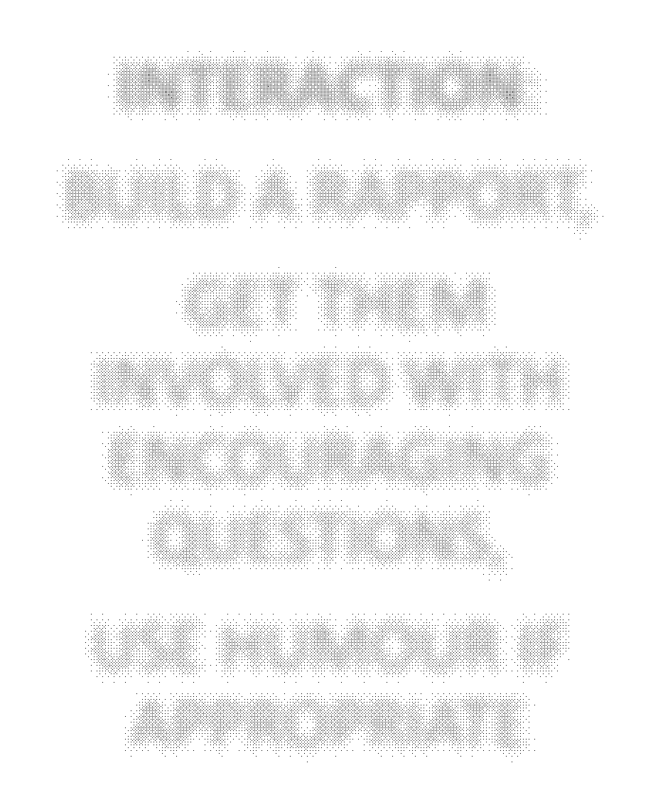


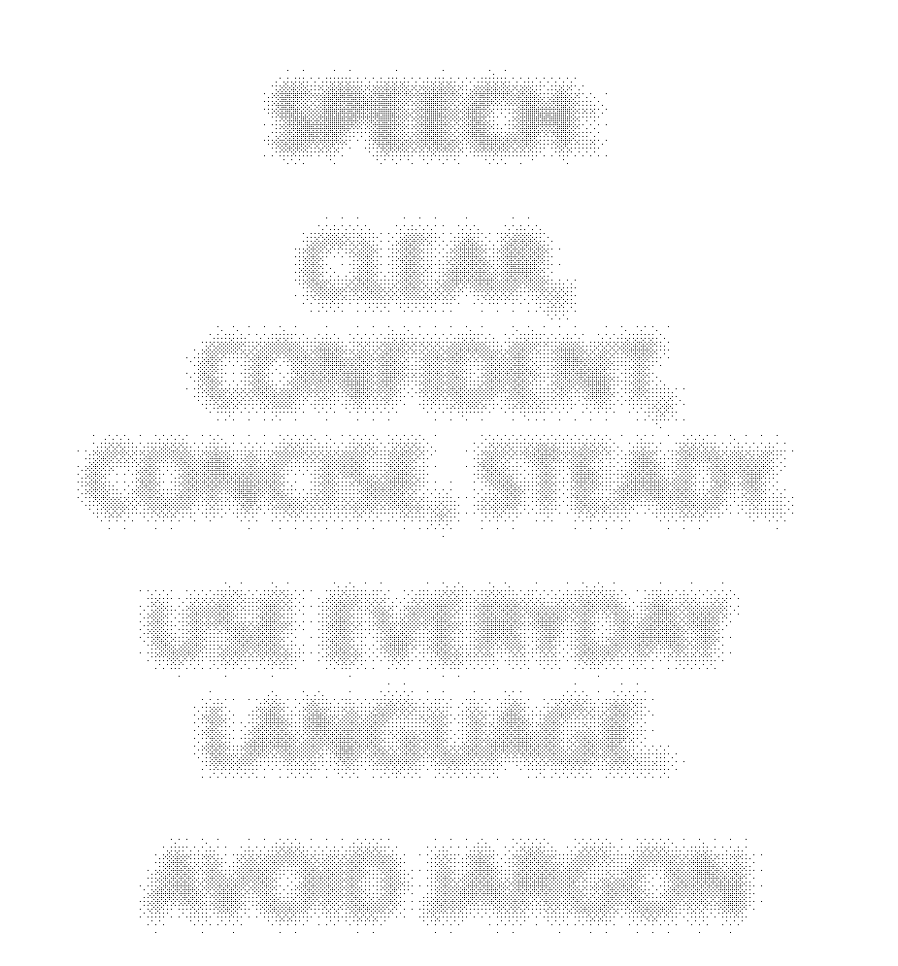
SATHYABAMA UNIVERSITY
UNIT-V English for Science and Technology –SHS1101
5.2 MAKING PRESENTATION ON GIVEN TOPICS
STRUCTURE:
HAVE A LOGICAL ORDER. INTRODUCTION, CENTRAL IDEAS, CONCLUSION
PRACTICE:
PRACTICE INFRONT OF MIRROR, TAKE YOUR FRIENDS OPINION
NOTES AND HANDOUTS THAT AUDIENCE CAN TAKE AWAY
POWERPOINT:
KEEP SLIDES SIMPLE AND NEAT,
USE CHARTS, DIAGRAMS AND PICTURES
PRESENTATIO N SKILLS
BODY LANGUAGE: SMILE,MAKE EYE CONTACT, MOVE AROUND
INTERACTION: BUILD A RAPPORT,
GET THEM INVOLVED WITH ENCOURAGING QUESTIONS,
USE HUMOUR IF APPROPRIATE
SPEECH:
CLEAR, CONFIDENT, CONCISE, STEADY.
USE EVERYDAY LANGUAGE.
AVOID JARGON
Page 1 of 27

Slide 5
SATHYABAMA UNIVERSITY
UNIT-V
English for Science and Technology –SHS1101
5.2.1 KEY PRESENTATION PHRASES
Introduction
Good morning, afternoon, evening, everyone. Thank you for coming. Today, tonight I’m going to talk about (the role of technology in education)
Intro to talk
I would like to start by… I shall begin by…
First, I will talk about… Then, Next, … After that, … And finally,…
Main part of talk
So, let us begin with…
Moving on to… Let’s move on to… My next point deals with…
And last but not least…
If everyone is clear on that point, I’ll move onto the next slide.
Generalizing
Although this is a bit of generalization, I would say that (Singapore is a cleaner city than Tokyo)
In the majority of cases, (girls outperform boys between the ages of 10 and 12) Looking at the broad picture, (language testing in Japan does not have a particularly bright future)
Being specific and giving examples
To give an example from my personal experience, (two member of my family suffer from dyslexia)
I think I can illustrate this point by telling you about the time (I went to Tanzania on a safari holiday)
To be specific, (I mean the downtown area between 3rd and 22nd Streets)
Summing up and ending the talk
To sum up, …
In conclusion, you can see that… Thank you for listening.
Does anyone have any questions?
Page 1 of 27

Slide 6
SATHYABAMA UNIVERSITY
5.2.2 TRY THIS!!!
UNIT-V
English for Science and Technology –SHS1101
MAKE A PRESENTATION ABOUT YOUR HOMETOWN!!!
TRANSPORT
CLIMATE ACCOMMODATION
ATTRACTIONS
5.2.3 FEW SUGGEST^{F}E^{O}D^{OD}TOPICS FOR PRESENTATION:
Technologies that will disappear in next five years Top 10 discoveries of the decade
Latest technology in automobiles Revolution in agriculture
Reference: https://tefltastic.wordpress.com/worksheets/presentations/ http://www.eslbase.com/worksheets
5.3 GIVING IMPROPTU TALKS
An impromptu talk is given with little or no preparation, usually about a topic that the speaker knows well.
Practice makes perfect.
Try each activity to practice impromptu speaking. Practicing is an important part of developing skills. Remember!!!
An impromptu speech should have a beginning, middle and end.
Don’t forget to use your presentation skills (body language) when you resent your talk.
5.3.1 FAVORITE MINUTE
Purpose: To practice speaking fluently and clearly.
In a group of two choose one topic from the given list. Think for 30 minutes about your topic. Speak to your topic for 1 minute on topic.
Page 1 of 27

Slide 7
SATHYABAMA UNIVERSITY
TOPICS:
UNIT-V
English for Science and Technology –SHS1101
My favourite food
My favourite place in the world My favourite book
My favourite expression My favourite person
Ask your partner for feedback:
Did I speak fluently?
Were my ideas well organized? Was my message clear?
Did I engage the audience?
CONNECT THE DOTS
The students will be given two random familiar nouns.
For instance: bird, wheelbarrow, hippopotamus, river, hammer, cow, witch, moon, grass, hat, elephant, computer, book, vase, photo, candlestick, shoe, painter, mug, plane, eclipse, operation, halo, knife, eye, storm, girl, pillow, lid, thermometer, jungle, barn, wheel, thistle, steam, mud ...
The player must tell a convincing story connecting two given nouns. The story need not be long, complicated or true.
Example: There lived a painter who travelled in a river to take a selfie with hippopotamus. The number of nouns can be included if the player is comfortable connecting more.
STORY STARTER:
Each speaker begins with an opener, building a brief story and extending it however they wish.
For example: 'It was a dark and stormy night', 'I wish people would not say ...', 'Yesterday I saw a herd of cows ', 'My favorite activity is bird watching', 'The wisest saying I ever heard was ...', 'In 20 years time I will be ...', 'It made me yell', 'All I want for Christmas is ...', 'Something is terribly wrong ...', 'The little voice inside my head ...', 'This is the secret I've never shared before', 'I never knew what happened ...', 'Sometimes I just want to ...', 'You know it's Summer when ...', 'Happy birthday to you, happy birthday to you', 'The story made me want to ...','I heard the best news this morning', 'The sound of people laughing...'
Reference: http://www.write-out-loud.com/public-speaking-games.html
http://lrrpublic.cli.det.nsw.edu.au/lrrSecure/Sites/Web/public_speaking/speech/lo/2008_136_PS_04/apple ts/ap400_interactives/ap403_activities.htm
Page 1 of 27

Slide 8
SATHYABAMA UNIVERSITY
5.4 Reading and Summarizing
UNIT-V
English for Science and Technology –SHS1101
Guided Reading and Summarizing Procedure
Preparing to read.
Look over the selection and think about what you already know about the topic.
Reading to remember.
Read a few paragraphs – as much as you think you can remember easily.
Turn over the article (or close the book) and brainstorm all the facts you remember.
Write these in your notebook.
After all information is recorded, quickly refer to the text for corrections and additions to the information.
Do not cross out or erase the original information, instead circle and rewrite new information in a new color or indicate changes with an arrow.
Continue this procedure until you have completed the selection.
Grouping remembered information.
Write down the major topics in the selection.
Using these topics, categorize the information, writing it under the appropriate headings.
Then, organize the remaining information.
You may even identify subcategories of information under each topic.
Writing the summary.
Before writing your summary from the notes, think about these ‘rules’ for summaries:
Include important information; leave out details that are not necessary to summarize the main topics.
Compress information by combining similar details.
Add words and/or phrases to make the summary cohesive and coherent.
After writing your summary, look it over to make sure it reads smoothly and relates all of the necessary details.
Look over the language choices you’ve made to revise for clearer meaning and more engaging text.
Page 1 of 27

Slide 9
SATHYABAMA UNIVERSITY
5.4.1 Example passage for summary writing
UNIT-V
English for Science and Technology –SHS1101
Read the passage given below and write a summary of the apssage.
The small village of Somnathpur contains an extraordinary temple, built around 1268 A.D. by the Hoyasalas of Karnataka-one of the most prolific temple builders. Belur and Helebid are among their- better-known works. While these suffered during the invasions of the 14th century, the Somnathpur temple stands more or less intact in near-original condition. This small temple captivates with the beauty and vitality of its detailed sculpture, covering almost every inch of the walls, pillars, and even ceilings. It has three shikharas and stands on a star-shaped, raised platform with 24 edges. The outer walls have a profusion of detailed carvings: the entire surface run over by carved plaques of stone. There were vertical panels covered by exquisite figures of gods and goddesses, with many incarnations being depicted. There were nymphs too, some carrying an ear of maize (a symbol of plenty and prosperity. The elaborate ornamentation, very characteristic of Hoyasala sculptures, was a remarkable feature. On closer look – and it is worth it – the series of friezes on the outer walls revealed intricately carved caparisoned elephants, charging horsemen, stylized flowers, warriors, musicians, crocodiles, and swans. The temple was actually commissioned by Soma Dandanayaka or Somnath (he named the village after himself), the minister of the Hoyasala king, Narasimha the Third. The temple was built to house three versions of Krishna. The inner center of the temple was the kalyanamandapa. Leading from here were three corridors, each ending in a shrine, one for each kind of Krishna-Venugopala, Janardana and Prasanna Keshava, though only two remain in their original form. In the darkness of the sanctumsanctorum, I tried to discern the different images. The temple’s sculptural perfection is amazing and it includes the doors of the temple and the three elegantly carved towers.
Ans.
Temple of Somnathpur
Notes
Prominent temples at Somnathpur:
built around 1268 A.D.
built by Hoyasalas.
built by most prolific temple-builders.
Belur and Helebid
suffered during the invasions of 14 century B. Temple: the beauty and vitality:
Detailed sculpture- covering walls, pillars, ceilings.
Three shikharas– stands star-shaped, raised platform – 24 edges
The outer walls- detailed carvings
Page 1 of 27

Slide 10
SATHYABAMA UNIVERSITY UNIT-V English for Science and Technology –SHS1101
the entire surface- carved plaques of stone,
Vertical panels covered by exq. Fig. of gods& goddesses C Characteristic of Hoyasala sculptures:
the series of friezes on the outer walls
revealed intricately carved caparisoned elephants .
charging horsemen
stylized flowers
warriors, musicians, crocodiles, and swans. D. Temple in the History:
actually comm.. Soma Dandanayaka or Somnath
inner center of temple was the kalyanamandapa.
Leading – three corridors, each ending in a shrine
Each kind of Krishna-Venugopala, Janardana and Prasanna Keshava, Life-test, of plu.
KEY TO ABBREVIATIONS
S.NO. ABBREVIATIONS WORDS
1. Inc. includes 2 Exq.exquisite
Fig. figures
Tstmny testimony
Plrlty Plurality
Comm..commissioned
Summary
Somnath temple is situated in a small village of Somnathpur. It was commissioned by Soma Dandanayaka or Somnath and it was build around 1268A.D. The temple of Somnath is extraordinary due to the sculptures on the walls, pillars, and even the ceiling which are covered by exquisite figures of gods and goddesses. The sculptures have a series of finches on the outer walls. The various molifs are carved elephants, charging horsemen and stylized flowers. It had three corridors, each ending in a shrine, one for each version of Krishna- Venugopala, Janardana and PrasannKeshava.

Slide 11
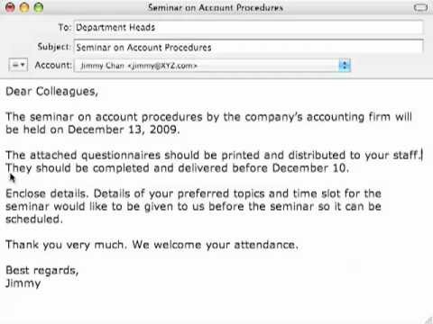
SATHYABAMA UNIVERSITY
5.4.2 Exercise
The Scientific Method in the Lab
UNIT-V
English for Science and Technology –SHS1101
The very first step in the scientific method is to state the problem. Once you have done this you can do some research and then form a good hypothesis. Then we test this by doing an experiment. We then analyze all of our data and finally form a conclusion.
There are a lot of safety rules that we must follow in the science lab as well. One piece of equipment we will use most often is goggles. If you spill harsh chemicals on your skin you should run it under water for at least 15 minutes. When smelling chemicals, never take a big sniff, always waft. Never ever start
a fire when the teacher is not in the room.
We have recently studied some general properties of matter. Area is the amount of surface covered by an object. On the other hand, volume is the amount of space occupied by an object; and the mass per unit of volume is known as density. The amount of matter in an object is called mass.
When doing a lab report two magic words must be included in the hypothesis. Those two magic words are If then. The materials should be written as a list. Charts and graphs will be found in the data section of the lab report.
Metric prefixes are a big part of measurement in science. The prefix kilo means 1000. The prefix milli is way on the other side of the chart and means .001. The prefix Deca means 10. The prefix Hecto means 100.
E-mail writing
Communication via e-mail or electronic mail has become the order of the day. This transformation has become vital as communication takes place faster and more efficient at a less cost. Though there are minor drawbacks like getting junked or hacking, if it is used with e-mail etiquettes in mind, then it is a real gift to humanity.
Use proper structure and layout.
Identify yourself and topic.
Let the message be brief and readable.
Edit carefully before pressing “send” option.
Use attachments sparingly.
Do not assume privacy. Sample:

Slide 12
SATHYABAMA UNIVERSITY UNIT-V English for Science and Technology –SHS1101
5.5.1 Observe the two columns. In one column, phrases from different types of emails and in the other column the email types are given. Match the phrases with the types.
Phrases | Email types
I am writing to express my dissatisfaction with… | A thank-you email
We are happy to inform you that you have been selected… | An invitation to a party
Please accept our apology for…. | An email congratulating someone.
I’d like to thank you for your…. | An email of apology
This is to invite you to join us… | An email of complaint
Prepare two emails with a similar purpose (e.g., an invitation to a Programme): one formal and one informal. Students will compare both emails by discussing: potential audience, email structure, language, tone, and stance.
Below are some of the formal and informal phrases used for communicative purposes .Identify which phrases are formal and which are informal.
Could you please let me know…?
Would you mind sending…
Can you call me….?
I would also like to know…
I would appreciate if you could…
Would you like me to….?
How about we meet tomorrow and I help you with…?
Do you think you could….?
Should you need any further information, please do not hesitate to contact me.
I would be glad to provide you with…..
Prepare an informal email with a particular communicative purpose (e.g., apologizing for a missed meeting). Provide a list of formal phrases that could be used in a formal email with the same purpose. Rewrite the original informal email to make it formal by using the target phrases.

Slide 13
SATHYABAMA UNIVERSITY
UNIT-V
English for Science and Technology –SHS1101
5.6 Reported Speech
Definition :
In order to report a dialogue, one should be well-versed in changing sentences from Direct Speech to Indirect Speech. Of course, we need not reproduce the actual words of the speaker exactly. We are more concerned with the sense of the utterance than in the literal repetition of the words. The following guidelines will help you to refresh what you have studied about the transformation of sentences from Direct to Indirect Speech.
Statements: When the utterance of the speaker is a statement we use the reporting verbs like‘say’, ‘tell’. The conjunction ‘that’ isused. In order to maintain the original sense of the speaker ‘say’ or ‘tell’ can be replaced with verbs like, suggest, agree, mutter, admit, insist, whisper, boast, state, remark, claim, object, protest, etc.
What are the differences between the direct speech and the indirect speech?
There are several differences between a sentence with direct speech and a sentence with indirect speech.
We no need to use quotation marks with indirect speech.
We have to change the tense of the verb.
We have to change the pronouns and determiners.
e.g
Dialogue - Reported form
He said, “I can speak four languages”.
He boasted that he could speak four languages.
Some more examples.Dialogue Reported form “Let’s go out for a walk”.
She suggested going out for a walk. “That mobile is mine”.
He claimed that that mobile was him. “Yes, I took the mobile”.
He admitted that he had taken the mobile. “You can’t arrest me”.
He protested that they could not arrest him. “You shouldn’t take my laptop”.
He objected that I shouldn’t take his atlas.
We can replace ‘tell’ with the following verbs according to the context: For example: complained, stammered, sneered, snapped, explained, declared, announced, groaned, promised, gasped, conceded, etc.

Slide 14
SATHYABAMA UNIVERSITY UNIT-V
Some Important Rules to Report the Dialogue: e.g:
Direct Speech
The boy said to his friend, “I am waiting for you here now.”
English for Science and Technology –SHS1101
Indirect Speech
The boy told his friend that he was waiting for him there then.
Changes to be noted: Kinds
Reporting Verb Pronouns Tense
Place Concept Time Concept
Dialogue
said to
I,you
am waiting here
now
Reporting told
he, him was waiting there
then
5.6.1 CHANGES IN:
A. Pronouns:
Direct Speech I, you
my, mine, your, yours we
our, ours us
Indirect Speech (Reported Speech) he, she, it
his, her, hers, its they
their, theirs
them
B. Tense:
Direct Speech (speaker’s words) Indirect Speech (Reporter or Listener)
Present tense am, is, are make, makes
am / is / are eating will / can / may eat has, have
has / have eaten
Past tense was, were made
was / were eating
would / could / might eat had
had eaten
Direct Speech (speaker’s words) Indirect Speech (Reporter or Listener)
Present tense was / were ate
was / were eating
Past perfect tense had been
had eaten
had been eating
C. Expressions of time and place indicating nearness are changed into one of distance:
Direct Speech
Indirect Speech (Reported Speech)

Slide 15
SATHYABAMA UNIVERSITY
now today tonight yesterday tomorrow
the day before yesterday the day after tomorrow last week
then that day
that night
the previous day / the day before the next / following day
two days before in two days
the previous week or the week before
UNIT-V English for Science and Technology –SHS1101
last month last year
the previous month or the month before
the previous year or the year before
next week / month / year a week / month
last night here
this / it these thus ago
the following week / month / year a week / month
the previous night there
that those so before
I. STATEMENTS: Kind of Sentences Reporting Verbs Conjunctions
Statement
said, told, suggested, admitted, remarked
that
Ordinary statements:
Example:
Direct Speech: Rosy said, “I have a habit of reading before I go to bed”.
Indirect Speech Rosy said that she had a habit of reading before she went to bed. Direct Speech: David said, ‘Here is the pen I borrowed yesterday, John.”
Indirect Speech: David said to John that there was the pen he had borrowed the previous day.
In reported speech people often leave out the conjunction that. Reported Speech
Sarah said that she felt ill.
Malika said that she couldn’t find her pen drive Peter said that David was hitting him.
When the reporting verb is in the present or future tense there is no change in the tense of the reported clause:
Example:
Direct Speech Sarah says, “I like kids”.
Indirect Speech Sarah says that she likes kids.
When the reporting verb is in the past tense the verb of the reported clause is changed into the corresponding past tense:
Example:
Direct Speech Mohan said, “I have written a novel”.

Slide 16
SATHYABAMA UNIVERSITY UNIT-V
Indirect Speech Mohan said that he had written a novel.
English for Science and Technology –SHS1101
Present Progressive used as a future form becomes would be + present participle, not Past Progressive:
Example:
Direct Speech She said, “I am seeing the dentist next week”.
Indirect Speech She said that she would be seeing the dentist the following week.
Simple Past / past Progressive in adverb clauses of time do not usually change into the corresponding past tense:
Example:
Direct Speech She said, “When I lived / was living in a village I faced a lot of hardships”.
Indirect Speech She said that when shelived / was living in a village she faced a lot of hardships. (Don’t use had lived / had been living)
Unreal past tense (subjunctive mood) after wish / it is time remains unchanged: Example:
Direct Speech She said, “I wish I were an angel.”
Indirect Speech She said that she wished she were an angel. (Don’t use had been)
Would rather / would sooner / had better remains unchanged:
Example:
Direct Speech He said, “I would rather starve than beg.”
Indirect Speech He said that he would rather starve than beg.
Verbs used in clauses expressing improbable or impossible condition remain unchanged: Example:
Direct Speech He said, “If won the election I would become a minister.”
Indirect Speech He said that if he won the election he would become a minister.
When the direct speech expresses universal truth (fundamental truths of science) saying / proves / habitual action, the tense does not change:
Example:
Direct Speech He said, “Habit is a second nature.”
Indirect Speech He said that habit is a second nature.
A noun / pronoun in the vocative case is made the object of a reporting verb or left out: Likewise a comment clause (parenthesis) is left out
Example: you see, as you know, to tell you frankly etc.
Words of expressions used just to introduce a sentence are left out: Well, very well, now, so etc.
Likewise a comment clause (parenthesis) is left out
Example: The teacher asked the children to listen to him. (now left out)
l. A statement employing all the techniques:

Slide 17
SATHYABAMA UNIVERSITY UNIT-V English for Science and Technology –SHS1101
Well, very well, now, so etc.
Likewise a comment clause (parenthesis) is left out Example:
Direct Speech My neighbor said, “My guests arrived last evening. They are staying with us today. They will be leaving early tomorrow morning.”
Indirect Speech My neighbor told me that her guests had arrived the previous evening and they were staying with them that day but they would be leaving early the following morning.
Sentence with the same concept should be joined with ‘and’ but when there is a contract use ‘but’.
II. QUESTIONS:
a. The reporting verbs for questions are: Kind of Sentences Reporting Verbs
Conjunctions
Questions (1) W/H type asked, enquired, wanted to know Questions (2) Verbal asked, enquired, wanted
if / whether
b. Auxiliary questions should begin with: if / whether e.g:
Direct Speech My friend said, “Are they coming with us?”
Indirect Speech My friend asked me whether they were coming with us. Direct Speech I said, “Were they angry with you?”
Indirect Speech I asked him whether they had been angry with him.
Direct Speech Sarah said to her mother, “Can the milkman bring milk in this heavy rain?” Indirect Speech Sarah asked her mother if the milkman could bring milk in that heavy rain.
c. Do / Does / Did Questions:
When using;
do, does (present tense) - the main verb converts into the past (does / do go -> went) did (past tense) - the main verb converts into past perfect. (did go -> had gone)
e.g:
Direct Speech “Does David study late at night?” said Sonia.
Indirect Speech Sonia asked me whether David studied late at night. Direct Speech Jems said, “Do the college students use cellphones?”
Indirect Speech Jems asked me whether college students used cellphones.
d. The question form will change into a statement form:
“Is he here?” Whether he was there
e. W/h Questions:
These questions begin with a question word (Who, What, When, Why, Where, How, How long ...). While changing such a question into reported form we do not use any conjunction. We simply invert the word order (Verb + Subject is changed into Subject + Verb). Do not use if/whether in W/h Questions.
e.g:
Verb + Subject Subject + Verb
She said to me, “What do you want?” She asked me what I wanted.
Direct Speech My neighbor said, “When did the men catch the stray dogs”
Page 17 of 27

Slide 18
SATHYABAMA UNIVERSITY UNIT-V English for Science and Technology –SHS1101
Indirect Speech My neighbor asked me when the men had caught the stray dogs. Direct Speech My friend said, “Which color will you choose?”
Indirect Speech My friend asked me which color I would choose?
Direct Speech Father said to mother, “Why was Angelina crying when she returned from school?” Indirect Speech Father asked mother why Angelina had been crying when she had returned from school.
f. Verbal Questions:
These are questions beginning with a verb. (Are you ready? Is it true?)
Here we use the conjunction ‘if’ or ‘whether’. The word order is changed as mentioned earlier. e.g:
Verb + Subject Subject + Verb
She said to me, “Is Tom at home?” Sh asked me if Tom was at home.
III. COMMANDS / ORDER / IMPERATIVE SENTENCES To report a command we can use a number of verbs Reporting Verb:
Kind of Sentences Reporting Verbs Conjunctions
Commands & Requests
told, asked, requested, warned, advised, instructed, ordered to - not to
We use the conjunction ‘to’. When the command is a negative one beginning with “Don’t” we change it to ‘not to’.
e.g:
Direct Speech The Captain said, “Get ready to board the ship.”
Indirect Speech The Captain commanded his sailors to get ready to board the ship. Direct Speech Teacher said to Jems, “Get out”
Indirect Speech Teacher told Jems to get out.
Direct Speech The Judge said to the culprit, “Tell me the truth.” Indirect Speech The Judge ordered the culprit to tell the truth.
Direct Speech Headmaster said to the students, “Don’t copy in the examination”. Indirect Speech Headmaster asked the students not to copy in the examination.
Requests:
Please - requested + whom + to + v
Direct Speech The teacher said, “Please improve your knowledge.”
Indirect Speech The teacher requested the student to improve his knowledge. Direct Speech Robert said to me, “Please post these letters”.
Indirect Speech Robert requested me to post those letters. Direct Speech Mother said, “Please keep your room neat.”
Indirect Speech Mother requested me to keep my room neat.
Exclamations
Exclamations can be reported with adverbs of manner.
Kind of Sentences Reporting Verbs Conjunctions
Exclamations
exclaimed with joy /exclaimed with sorrow
that

Slide 19
SATHYABAMA UNIVERSITY UNIT-V
Reporting Verb: exclaimed with (emotion)
The exclamation should be changed into a statement.
Use suitable emotions to the exclamation.
English for Science and Technology –SHS1101
Direct Speech Rosy said to David, “How wonderfully you sang!”
Indirect Speech Rosy exclaimed with happiness that David had sung wonderfully. Direct Speech The foreigner said, “What a man Obama is!.”
Indirect Speech The foreigner exclaimed in wonder that Obama was a great man. Direct Speech John said, “That I should see you here!”
Indirect Speech John was surprised to see me there. Alas!- exclaimed with sadness / regret / disappoinment.
Direct Speech The reporter said, “Alas! Many lives have been lost due to tsunami”
Indirect Speech The reporter exclaimed sadly that many lives had been lost due to tsunami.
May you!- blesses / wished.
Direct Speech The grandmother said, “May you meet with success wherever you go”
Indirect Speech The grandmother blessed her grandson that he should meet with success wherever hegoes.
Don’t / never - warned or forbade. (when using forbid do not use negatives) Direct Speech Father said, “Shakshi, don’t play in dirty water!”
Indirect Speech Father forbade his daughter Sakshi to play in dirty water. O God! - called upon God with regret / sadness / disappointment.
Direct Speech The beggar said, “O God! I have been cheated”.
Indirect Speech The beggar called upon God with regret that he had been cheated.
DIALOGUE REPORTING EXAMPLES
Read the following examples and find out how the utterance of the speaker is reported.
Teacher, Student,
“Can you read French?”
“No Madam, I find French very difficult”.
Ans: The teacher asked the student if he could read French. The student replied in the negative stating that he found it very difficult.
Father,“Is tomorrow a holiday?”
Son, “Yes, it is Sunday and so it is a holiday”.
Ans: Father asked son if the next day was a holiday. Son replied in the positive and added that being Sunday it was a holiday.
Monica, “Return me my laptop if you have worked.” Sania, “Here it is, Thank you!”
Ans: Monica asked Sania to return her laptop if she had worked. Sania returned it, thanking her. Antony, “Where are you going?”
Peter, “To the market”. Antony, “May I join you”? Peter, “It will be a pleasure”.
Ans: Antony asked Peter where he was going. Peter replied that he was going to the market. Antony asked if he could join him. Peter said that it would be pleasure.

Slide 20
SATHYABAMA UNIVERSITY UNIT-V
English for Science and Technology –SHS1101
Passenger Conductor Passenger
Please give me three tickets to Paris. How much is it? Six dollors a ticket.
Okey.Here’s six dollors.
Ans: The passenger requested the conductor to give him three tickets to Paris and asked how much it was. The conductor replied that it was six dollors a ticket. The passanger paid six dollors.
Activity:
Report the following Paragraph to your friend:
“‘Whoosh, whoosh’ that is the sound of wind hitting against the sails on the Santa Maria in 1492. Without the power of the wind, Columbus would have never been able to reach his destination. There are lots of things that are powered by wind. For example, kites and airplane gliders are propelled by wind. One thing wind gives us that we need and use every day is electricity. Making electricity from wind energy is not as easy as flying a kite. It has more steps and is alot more complicated. Lets learn how. . .” said web mutations
You have to use indirect speech / reported speech if you want to report a quoted sentence into a statement. In this case, the quoted sentence will have changes in the tense, structure, adverbial clauses and pronouns.
Try converting the following quoted sentences (direct speech) to reported sentences, with the necessary changes:
For Statements
[Subject + Predicate (modal verb if necessary + verb) + Object + Adverbs (place, time …)]
Robin said, “A small windmill can supply the power needs of an all-electric home or small business”
Robin informed me that . . . . . . . . . . . . . . . . . . . . . . . . . . . . . . . . . . . .
The Director said, ”The company has not been able to achieve its pro-duction target this year”.
The Director regretted that . . . . . . . . . . . . . . . . . . . . . . . . . . . . . . . . . .
For Wh-question:
[Wh-question pronoun + Subject + Predicate (modal verb if necessary + verb) + Object + Adverbs (place, time)]
Suman said to Sanjeev, “When did you operate the device”?.
Suman enquired Sanjeev . . . . . . . . . . . . . . . . . . . . . . . . . . . . . . . . . . . . . b. How long have you been working on this project?. . . . . . . . . . . . . . . . . .
. . . . . . . . . . . . . . . . . . . . . . . . . . . . . . . . . . . . . . . . . . . .
For Yes-no question:
[whether /if + Subject + Predicate (modal verb if necessary + verb) + Object + Adverbs (place, time] a. “Are you going to start a new company anyway?” . . . . . . . . . . . . . . . . .
. . . . . . . . . . . . . . . . . . . . . . . . . . . . . . . . . . . . . . . . . .
Ramesh said to Kamalesh. “Are you waiting here for the lab technician?” Ramesh asked Kamalesh. . . . . . . . . . . . . . . . . . . . . . . . . . . . . . . .

Slide 21
SATHYABAMA UNIVERSITY
For a command / suggestion / request:
[to+infinitive]
UNIT-V
English for Science and Technology –SHS1101
The Boss said to the technician “Repeat the process”
The Boss ordered the technician. . . . . . . . . . . . . . . . . . . . . . . . . . . . .. . .
The Junior Engineer said to his assistant, “Learn English through online course”
The Junior Engineer. . . . . . . . . . . . . . . . . . . . . . . . . . . . . . . . . . . .
For Negative commands
[not+ to+infinitive]
a. “Don’t turn off the power supply!”
The Engineer told his assistant. . . . . . . . . . . . . . . . . . . . . . . . . . . . b. “Don’t leave your work incomplete.”
Mercy Meriem . . . . . . . . . . . . . . . . . . . . . . . . . . . . . .
Change the following sentences into reported speech.
Charles said to the teacher “I didn’t have time to do my homework.”
The Principal says, “The young people of today are tomorrow’s leaders.”
Do you know how to operate a computer?” asked the personnel officer.
“Don’t push!” the conductor said to the passengers who were boarding the bus.
“Meet me in the department tomorrow,” the Professor said.
“Don’t worry about the exams. Work hard,” my mother said.
5.7 Homophones/Homonyms- Confusable words
The term ‘confusable’ refers to two or more words that are commonly or easily confused with one another, e.g., they’re with ‘there’ and ‘their’. There are many a factors that lead to such confusion.
Homophones are words that have the same sound but different spellings and meanings: slay, sleigh.
Homographs are words that have the same spelling, but different sounds and meanings: wind.(n) - moving air, wind (v) - to turn or twist.
5.7.1 Frame sentences using each of the words given below:
Word | Meaning | Sentence
aweful | filled with awe
Awful | really bad
Bait | to torment
Bate | to lessen
Bard | a poet
barred | enclosed by poles
Baron | minor royalty
barren | unable to bear children
Bold | Brave
bowled | knocked over
boulder | large rock
ceiling | top of the room
sealing | to close a package or envelope
Cite | to refer to

Slide 22
SATHYABAMA UNIVERSITY
UNIT-V
English for Science and Technology –SHS1101
Sight | Vision
Site | a location
council | group of leaders
counsel | Advisor
Choose the appropriate word from the options (homophones) given:
Usually one road is used to (access/asses) the Wind Park and only small dirt roads may be needed to access each turbine at the project (site/sight). These roads will be built
(solely/ souly) where the company has (received/perceived) landowner connect each turbine are almost (allways/always) constructed underground unless (prohibited/inhibited) for specific environmental reasons.One new above-ground connection line, approximately six miles long, will be constructed across private (lands/lends) already under (leas/lease) for connection to the (existing/exiting) RockyMountain Power (230kV line) electricity (grid/grit).
Read the following Ode and rewrite with the appropriate words (homophones) wherever necessary:
Prays the Lord for the spellingchequer That came with our pea sea!
Mecca mistake and it puts you rite Its so easy to ewes, you sea.
I never used to no, was it e before eye? (Four sometimes its eye before e.)
But now I’ve discovered the quay to success It’s as simple as won, too, free!
Sew watt if you lose a letter or two,Thewhirled won’t come two an end!
Can’t you sea? It’s as plane as the knows on yore face S. Chequer’smy very best friend
I’ve always had trubble with letters that double “Is it one or to S’s?” I’d wine
But now, as I’ve tolled you this chequer is grate And its hi thyme you got won, like mine.
—Janet E. Byford
5.8CREATIVE WRITING
I believe there is a writer inside of all of us.
Even if you don’t think you write well, you must have something to say. You have a story to tell, knowledge to impart, and experiences to share.

Slide 23
SATHYABAMA UNIVERSITY UNIT-V English for Science and Technology –SHS1101 You’ve lived a full life that is packed with observations and adventures, and you shouldn’t exit this Earth without transferring them in some way. Whether you write fiction or non-fiction, your life is the laboratory for creating a great book or story.
If you can talk, you can write — even if you need to brush up on grammar and spelling. You will naturally become a better writer when you write more. You will learn how to organize ideas, make smooth transitions, and expand your vocabulary. Reading also improves your writing, so if you have the smallest desire to write well, read a wide variety of books in different genres.
You can accelerate your writing competence with some simple writing exercises. Your inner creative muscle needs exertion to stay fit and strong — but writing exercises do not necessarily need to be hard work. They can be fun and exciting as you see how much creative juice you have just waiting to be squeezed.
These exercises should be practiced without self-judgment, inner filters, or concern about what a reader might think. The purpose is to allow your creative mind complete freedom to cut loose. You don’t have to show this writing to anyone if you don’t want to.
Try a different exercise every week to see what catches your imagination and awakens your inner author.
5.7.1 Here are some creative writing exercises to get you started:
1. Answer 3 questions.
In this exercise, you will use three questions to stimulate creative thought. You can write these questions yourself, but I’ll give you some examples to show you what to do.
You want to answer the questions as quickly as you can, with whatever ideas pop into your mind. Write as much or as little as you wish, but just allow the words to flow without pondering too much what you want to say.
Example 1:
Who just slipped out the back window? What were they carrying?
Where were they going? Example 2:
Who is Nathan? Why is he crying?
What is he going to do about it? Example 3:
Whose house is James leaving?

Slide 24
SATHYABAMA UNIVERSITY
Why was he there?
UNIT-V
English for Science and Technology –SHS1101
Where is he going now?
Write a letter to your younger ‘self’.
In this exercise, you are writing to yourself at a younger age. It can be your childhood ‘self’ or yourself just a few years back. You can offer advice, compassion, explanation, forgiveness, or praise. Or you can simply recount an experience you had and how it impacted you as your adult self now.
Try to see this younger self as a real and separate person when you write the letter. This exercise helps you think about your reader as a real person with emotions — a person who can be moved and inspired by your writing.
Again, try not to overthink this exercise. Spend a few minutes deciding the central message of the letter, and then just start writing without filters.
Use writing prompts.
Writing prompt is an idea that starts the writing process. The prompt can be a short sentence, a paragraph, or even a picture, but the purpose is the same — to ignite your creativity so you will begin writing.
Here are a few prompts you can use:
You wake up on a beautiful Sunday morning, feeling happy and ready to take on the day. Then you remember. A wave of anxiety washes over you, and the beautiful day turns foreboding in an instant. Who are you? Where are you? What has happened to make you feel anxious and ruin your day?
You are taking a walk on the beach early in the morning. The beach is nearly deserted. You notice something half buried in the sand, and when you examine it you see it’s an old, rusted metal box. You open the box. What’s inside the box? How does it make you feel? What are you going to do about?
You are sitting on the couch watching TV when you notice a receipt on your coffee table. You know you didn’t leave a receipt there, and you live alone. What is the receipt for? How did it get on your coffee table?
Write about your expertise.
Think about something you know how to do well. It can be anything from washing the dishes to selling stocks. Write a few paragraphs (or more if you wish) explaining some aspect of how to do what you do. Assume your reader is completely ignorant about the subject.
This writing should not sound like a dry instruction manual. Try to write in a conversational style, as though you are verbally explaining the process. Break down the steps in a way that makes the reader understand exactly what to do, without using business jargon or buzzwords.
Write a story told to you.

Slide 25
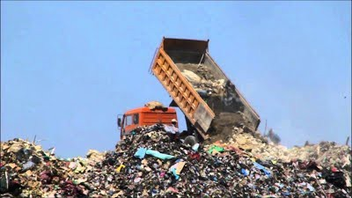

SATHYABAMA UNIVERSITY UNIT-V English for Science and Technology –SHS1101 In this exercise, you want to retell a story told to you by another person. It can be either a story that one of your parents or grandparents shared about something that happened many years ago, or it can be a more recent event a friend or family member recounted.
Or you can tell a story you learnt in school or through reading about a well-known person or event. The story can be funny, sad, or educational — but it should be interesting, entertaining, or engaging in some way.
6. Write about something or someone who changed your life.
In this exercise, rather than telling the story of someone else or pretending to be another person, you want to share your story from your perspective. Write about a person or event that has deeply impressed you and changed your life.
Rather than simply recounting the situation, talk about how it made you feel, what your reactions were, and how you were changed on the inner as well as the outer. Pour your heart into this writing.
View these exercises as means to opening doors of insight and imagination and enjoy the process of becoming a better writer.
5.7.2 A Picture’s Worth a Thousand Words: Look at the given images and brainstorm about the possible events behind the captured images

Slide 26

SATHYABAMA UNIVERSITY
UNIT-V
English for Science and Technology –SHS1101
Similes and Metaphors
A simile is where two things are directly compared because they share a common feature. The word AS or LIKE is used to compare the two words. Eg. As cold AS a dog's nose
A metaphor also compares two things, but it does so more directly WITHOUT using as or like. Eg. The shop was a little gold-mine.
Task One
Copy these sentences into your book. At the end of the sentence, write in brackets whether the sentence is an example of a metaphor or simile.
Eg. The clouds were fluffy like cotton wool. (SIMILE)
As slippery as an eel.
Arnie was a man-mountain.
He was a lion in battle.
She is as pretty as a picture.
The striker was a goal machine.
The torch lit up the room as if the sun had risen early.
The moon was a misty shadow.
My friend has a face like a bag of spanners.
5.9.2 Task Two
Now you are going to make up similes of your own by copying and finishing these sentences. For example:

Slide 27
SATHYABAMA UNIVERSITY
As good as gold
As heavy as
As cold as
As hard as
She had skin like a
As cool as
As quick as
He was slow like a
Slippery like a
UNIT-V
English for Science and Technology –SHS1101

